Slide 1


Take off with Tabular Editor
Sue Bayes

Slide 2


Slide 3

Sue Bayes
Data Analyst & Power BI Developer
Own business
Data Platform MVP
Devon & Cornwall Meet Up Group
Running addict
Time is important
Notes:
https://www.meetup.com/devon-and-cornwall-power-bi-meetup-group/

Slide 4
Tabular Editor 2
What is it?
How much is it?
How do I get it?
Why?
Limitations?
Notes:
https://github.com/TabularEditor/TabularEditor
Tabular Editor 2.x is a free, open-source, tool that lets you easily manipulate and manage measures, calculated columns, display folders, perspectives and translations in Analysis Services Tabular and Power BI XMLA Models (from Compatibility Level 1200 and onwards). The tool is written entirely in .NET WinForms (C#).
Cannot add, edit or remove tables, if you open it as an external tool however if you save pbix as pbip, then you can open pbip in TE2 and no limitations
Off line
Release 2.25 · TabularEditor/TabularEditor · GitHub

Slide 5
Why?
Edit Tabular Object Model
Editing & renaming Objects
Creating Measures
Object dependency
Search box
BPA
Advanced scripting
Notes:
Features: https://docs.tabulareditor.com/te2/Features-at-a-glance.html
Scripting: https://docs.tabulareditor.com/te2/Useful-script-snippets.html
BPA: https://github.com/microsoft/Analysis-Services/blob/master/BestPracticeRules/BPARules.json

Slide 6
DEMO

Slide 7
Why?
Edit Tabular Object Model
Editing & renaming Objects
Creating Measures
Object dependency
Search box
BPA
Advanced scripting
Notes:
Features: https://docs.tabulareditor.com/te2/Features-at-a-glance.html
Scripting: https://docs.tabulareditor.com/te2/Useful-script-snippets.html
https://www.elegantbi.com/post/datapreview
BPA: https://github.com/microsoft/Analysis-Services/blob/master/BestPracticeRules/BPARules.json

Slide 8
Tabular Editor 2
What is it?
How much is it?
How do I get it?
Why?
Limitations?
Notes:
https://github.com/TabularEditor/TabularEditor
Tabular Editor 2.x is a free, open-source, tool that lets you easily manipulate and manage measures, calculated columns, display folders, perspectives and translations in Analysis Services Tabular and Power BI XMLA Models (from Compatibility Level 1200 and onwards). The tool is written entirely in .NET WinForms (C#).
Cannot add, edit or remove tables, if you open it as an external tool however if you save pbix as pbip, then you can open pbip in TE2 and no limitations
Off line
Release 2.25 · TabularEditor/TabularEditor · GitHub

Slide 10
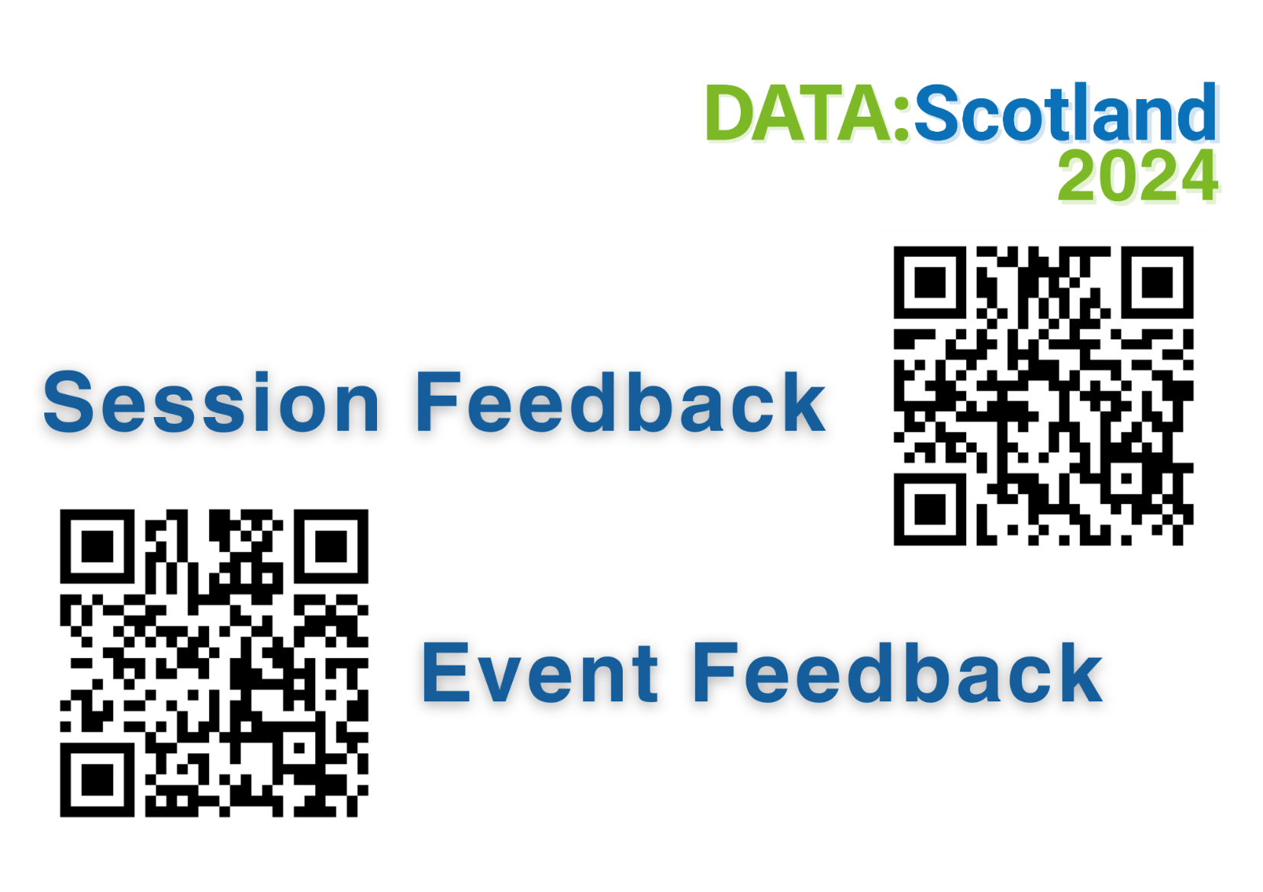
Resources
https://github.com/databayes/Session_Resources

Slide 11
Resources
Tabular Editor 2 or 3?
TE2 by Daniel Otykier
Tabular Editor 3 free training course
Taking the Fear out of Tabular Editor – Data Weekender

